Slide 1
Shakedowns Locations
for Philmont Crews
Presented By:
Karen “BigK” Rosencrans
January, 2017
It’s Not Just a Hike!

Slide 2
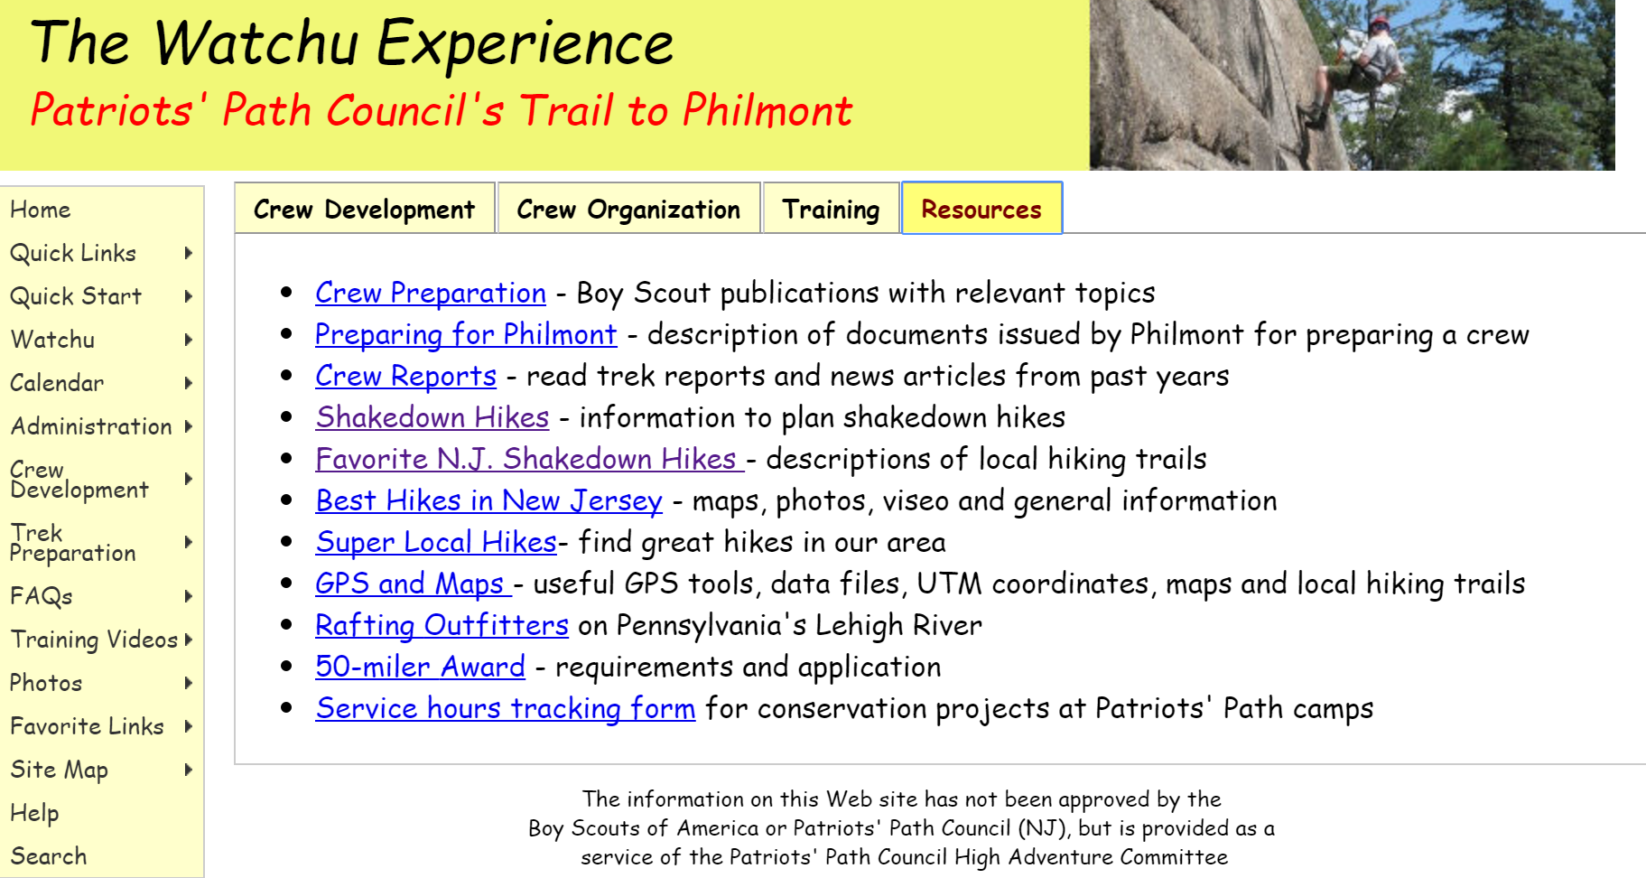

Slide 3
NJ Day Hikes
NJ County Parks
* Lewis Morris County Park (Morristown)
* Mahlon Dickerson Reservation (Jefferson)
* Pyramid Mountain (Boonton View of NYC)
* Silas Condict and SplitRock Loop (Kinnelon) – Indian Cliff (10 miles)
* Ramapo Reservation (Mahwah) – 5 new trails clearly blazed
* Schooley’s Mtn Park (Long Valley)
* Highlands Trail From Storm King (NY) to Delaware River (End to End)
New Jersey / New York State Park Service
* Delaware Water Gap: Mt. Tammany to Sunfish Pond circuit hike
* Stokes - (Branchville,NJ) Blue Mountain Loop trail
* Allamuchy Mountain State Park (Camp Wheeler)
* Norvin Green, (Ringwood), park at Weis Center
* Waywayanda State Park (Hewitt) - (1000 steps and boardwalk across wetlands)
* Watchung Reservation (Mountainside)(with historical trail brochures fun facts!)
* Cheesequake State Park (Matawan) - (Flat terrain)
* Lusscroft Farm Loop (Sussex)
* Harriman State Park (Sloatsburg, NY) – AMC Harriman Outdoor Center for beginners
National Park, Entrance Fee.
* Jockey Hollow, Grand Loop Trail
* Sandy Hook, Flat terrain

Slide 4
Question?: Why Overnights are preferred for Philmont Bound Crew Shakedowns?
Answer: More time as a team learning backpack camping skills…results in more time for program at Philmont. Try to accomplish 3 Backpack Shakedowns prior to Philmont:
1st is one night out, 15 miles over Sat to Sunday, Fall
Level 1 Educational Objective: Not outside comfort level.
Hike on Moderate terrain. Learn basic campsite setup, Philmont tarp, bear bag and cooking and cleanup. Stay south, less snow, warmer temp or plan for heated shelter. Not outside comfort level.
2nd is two nights out, 25 miles with one day a 12-14 miler. Spring
Level 2 Educational Objective: Moving beyond standard backpacking abilities.
Easy terrain. Learn pacing to hike as a group one pace for all. Hone skills of water planning and purification. Pick an area like south Jersey Pine Barrens, flat rolling terrain during a school shutdown (Spring break, early April).
3rd is 3 nights out, over 15 miles, Friday to Monday (Memorial Day Weekend),
Level 3 Educational Objective: Leading and following youth leaders – challenging and physically demanding.
Hike on strenuous long day terrain, possible stream crossing, ie, above treeline or exposed peak, use hands for balance when walking, work together as a crew
Connecticut AT,
New York (Catskills or Adirondacks),
New Hampshire/Vermont

Slide 5
Other Areas for Backpack Shakedowns
The Appalachian Trail
*AT in NJ - AT anywhere from Delaware Water Gap to High Point
Example: Kittatinny Boy Scout Camp to NoBeBoSco (Northern NJ Council)
(EARN a Patch! Venturers earn Venturing the AT Pin!),
* NY in Harriman and or head West from Harriman NY to NJ to High Point State Park. In Harriman - Must camp at shelter area only and arrive before dusk. 4 shelters with water are available along route. (No reservation fee)
* PA side from Wind Gap to Delaware Water Gap.
* CT-MA State Line – Challenging Terrain
* Shenandoah National Park, Virginia
* AT New Hampshire with AMC Hut system
Bergan County on Hudson:
* The Long Path (at GWB and Palisades Cliffs) possible camp at Alpine Scout Camp
NY Catskills:
* Shelters are available for overnight stays and DEC campgrounds (no fee)
suggest, North-South Lake near Katterskill falls and Escarpment trail

Slide 6
Backpacker Merit Badge Requirements:
Participate in at least 3 backpacking treks of at least 3 days each and at least 15 miles each, and using at least two different campsites on each trek.
Hiking Merit Badge Requirements:
Take 5 hikes, each on a different day, and each of 10 continuous miles.
You may stop for as many short rest periods as needed, as well as one meal,
during each hike, but not for an extended period (example: overnight).
Take a hike of 20 continuous miles in one day following a hike plan you
have prepared. You may stop for as many short rest periods as needed,
as well as one meal, but not for an extended period (example: overnight).

Slide 7
Shakedowns for Philmont Crews
It’s Not Just a Hike!

